Slide 1
Keras – Custom Training Loops
A short Introduction
Informatik

Slide 2
Keras – Out-of-the-box Training Loop
In Keras a model can be trained as simple as
Model definition
model = tf.keras.models.Sequential(...)
Model compilation
model.compile(...)
Model fitting
model.fit(...)
But you do not have any control on how the training happens.
For example this method cannot be used for GANs.

Slide 3
The 3 main components of a neural network model
The neural network architecture (type of network, number of layers, etc.)
The loss function (the one we want to minimise)
The optimiser (the algorithm to find the minimum of the loss function)

Slide 4
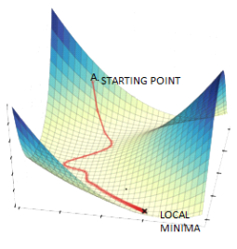
Gradient Descent
Image source: https://www.datasciencecentral.com/alternatives-to-the-gradient-descent-algorithm/, Accessed on 20/8/2022

Slide 5
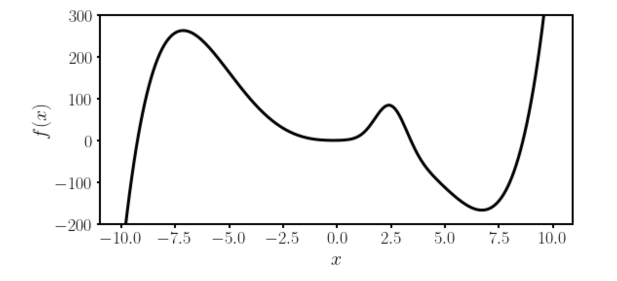
Gradient Descent I
Local minimum
Absolute minimum
Let’s suppose we want to find the absolute minimum of a given function $f(x)$.

Slide 6
Gradient Descent II
There is no analytical solution to the position of the absolute minimum for a network function.
Thus numerical methods are required.

Slide 7


Gradient Descent III
The most used method is called Gradient Descent and uses the following formula (in 1-Dimension)
$$x_{n+1}→x_{n}−γ \frac{df}{dx}(x_{n})$$
Slope of the
function to be
minimized
New minimum location
approximation
Previous minimum location
approximation
Learning rate
The starting point $x_{0}$ is crucial.
Which one should we choose? Does it make a difference?

Slide 8
Some remarks about gradient descent
To use gradient descent you will need the derivative (or gradient in multiple dimensions) of the function you want to minimize.
Due to this reason methods as autodifferentiations and back-propagations have been developed to be able to calculate the derivative of a generic network function.
→ Gradient descent is not the most efficient way of finding minima. It gets easily stuck in local minima. More advanced optimisers have been developed and are typically used (see Adam).

Slide 9
The concept of the GradientTape()
tf.GradientTape() is an automatic differentiation tool provided by TensorFlow.
It records operations for automatic differentiation, which is essential for training machine learning models.
import tensorflow as tf
# Define a simple model
def model(x):
return x * w + b
# Initialize variables
w = tf.Variable(5.0)
b = tf.Variable(1.0)
# Define input
x = tf.constant(3.0)
# Use GradientTape to record the computation
with tf.GradientTape() as tape:
y = model(x)
loss = (y - 10)**2
# Calculate gradients
gradients = tape.gradient(loss, [w, b])
# Display gradients
print("Gradients:", gradients)
Gradients: [<tf.Tensor: shape=(), dtype=float32, numpy=36.0>, <tf.Tensor: shape=(), dtype=float32, numpy=12.0>]

Slide 10
The concept of the GradientTape()
tf.GradientTape() is an automatic differentiation tool provided by TensorFlow.
It records operations for automatic differentiation, which is essential for training machine learning models.
import tensorflow as tf
# Define a simple model
def model(x):
return x * w + b
# Initialize variables
w = tf.Variable(5.0)
b = tf.Variable(1.0)
# Define input
x = tf.constant(3.0)
# Use GradientTape to record the computation
with tf.GradientTape() as tape:
y = model(x)
loss = (y - 10)**2
# Calculate gradients
gradients = tape.gradient(loss, [w, b])
# Display gradients
print("Gradients:", gradients)
Gradients: [<tf.Tensor: shape=(), dtype=float32, numpy=36.0>, <tf.Tensor: shape=(), dtype=float32, numpy=12.0>]
=36
=12

Slide 11
Example on real models
epochs = 2 for epoch in range(epochs): # Iterate over the batches of the dataset.
for step, (x_batch_train, y_batch_train) in enumerate(train_dataset): # Open a GradientTape to record the operations run # during the forward pass, which enables auto-differentiation. with tf.GradientTape() as tape: # Run the forward pass of the layer. # The operations that the layer applies # to its inputs are going to be recorded # on the GradientTape. logits = model(x_batch_train, training=True) # Logits for this minibatch
# Compute the loss value for this minibatch. loss_value = loss_fn(y_batch_train, logits)
grads = tape.gradient(loss_value, model.trainable_weights) optimizer.apply_gradients(zip(grads, model.trainable_weights))

Slide 12
DEMO

Slide 13
Wir danken Ihnen für Ihre Aufmerksamkeit

